Slide 1
Binary numbers
Mack 2021

Slide 2

Binary numbers
As humans, we typically represent numbers in the decimal system. Counting to ten is as simple as 1, 2, 3, 4, 5, 6, 7, 8, 9, 10.
As we just learned, computers represent all information in bits. In order to represent numbers with just 0, 1, computers use the binary number system. Here's what it looks like when a computer counts to ten: 0001, 0010, 0011, 0100, 0101, 0110, 0111, 1000, 1001, 1010.

Slide 3
Refresher: Decimal numbers
Before exploring how the binary system works, let's revisit our old friend, the decimal system. When you learned how to count, you might have learned that the right-most digit is the "ones' place", the next is the "tens' place", the next is the "hundreds' place", etc.
Another way to say that is that the digit in the right-most position is multiplied by 1, the digit one place to its left is multiplied by 10, and the digit two places to its left is multiplied by 100.

Slide 4
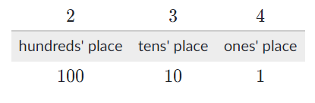
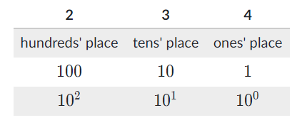
Let's visualize the number 234:
When we multiply each digit by its place, we can see that 234 is equal to (2 * 100) + (3 *10) + (4 *1).
We can also think of those places in terms of the powers of ten. The ones' place represents multiplying by 10^0 start superscript, 0, end superscript, the tens' place represents multiplying by 10^1, start superscript, 1, end superscript, and the hundreds' place represents multiplying by 10^2, squared. Each place we add, we're multiplying the digit in that place by the next power of 10.

Slide 5
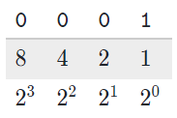
Binary numbers
The binary system works the same way as decimal. The only difference is that instead of multiplying the digit by a power of 10, we multiply it by a power of 2.
Let's look at the decimal number 1, represented in binary as 0001:
That's the same as (0×8)+(0×4)+(0×2)+(1×1), or 0 + 0 + 0 + 1.
Okay, perhaps you could have guessed that one — now for a bigger number!

Slide 6
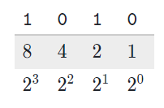

The decimal number 10 is represented in binary as 1010:
That's the same as (1×8)+(0×4)+(1×2)+(0×1), or 8 + 0 + 2 + 0.
Indeed, binary 1010 equals the decimal 10.

Slide 7
Now you try it: How would you represent the decimal number 666 in binary?
Notes:
🍐 This is a Pear Deck Multiple Choice Slide. Your current options are: A: 0111, B: 1000, C: 0101, D: 0110,
🍐 To edit the type of question or choices, go back to the "Ask Students a Question" in the Pear Deck sidebar.

Slide 8
Converting decimal to binary
Here's my favorite way to convert decimal numbers to binary:
Grab a piece of paper or a whiteboard.
Draw dashes for each of the bits. If the number is less than 16, draw 4 dashes. Otherwise, for numbers up to 255, draw 8 dashes. Bigger numbers than that require more bits and take a while to do by hand, so let's focus on the smaller numbers.
Write the powers of 2 under each dash. Start under the right-most dash, writing 1, then keep multiplying by 2.
Now start at the left-most dash and ask yourself "Is the number greater than or equal to this place value?" If you answer yes, then write a 1 in that dash and subtract that amount from the number. If you answer no, then write a 0 and move to the next dash.
Keep going from left to right, keeping track of how much remainder you still need to represent. When you're done, you'll have converted the number to binary!
Notes:
In case you're wondering: there's only one way to represent any given number in binary, just like there's only one way to represent any given number in decimal. Any technique that you use for converting a decimal to binary number should yield the same number.

Slide 9
How would you represent the decimal number 11 in binary?
Notes:
🍐 This is a Pear Deck Multiple Choice Slide. Your current options are: A: 1011, B: 1010, C: 1100, D: 1111,
🍐 To edit the type of question or choices, go back to the "Ask Students a Question" in the Pear Deck sidebar.

Slide 10
Let's go bigger. How would you represent the decimal number 25 in binary?
Notes:
🍐 This is a Pear Deck Multiple Choice Slide. Your current options are: A: 00011001, B: 00011010, C: 00011111, D: 00010111,
🍐 To edit the type of question or choices, go back to the "Ask Students a Question" in the Pear Deck sidebar.

Slide 11
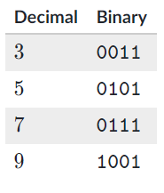
Patterns in binary numbers
In those last two questions, you converted odd numbers. There's something interesting about odd numbers in binary. Here are a few more odd numbers to give you an idea:
Do you see the pattern?
Notes:
🍐 This is a Pear Deck Text Slide
🍐 To edit the type of question, go back to the "Ask Students a Question" in the Pear Deck sidebar.

Slide 12

CHECK YOUR UNDERSTANDING
If you think you figured it out, try this question: which of the following very large binary numbers is odd?
Notes:
🍐 This is a Pear Deck Multiple Choice Slide. Your current options are: A: 0101010101010110, B: 0101010111010000, C: 0101110101010110, D: 0101010101010101,
🍐 To edit the type of question or choices, go back to the "Ask Students a Question" in the Pear Deck sidebar.
You don't actually need to convert those large numbers to decimal to answer the question—you only need to look at a single bit of information—the very last bit. The last bit is always the ones' place, and if a number is odd, it must have a 111 in that ones' place. There's no way to create an odd number in the binary system without that ones' place, since every other place is a power of 222. Knowing this can give you a better intuitive understanding of binary numbers.

Slide 13
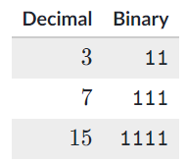
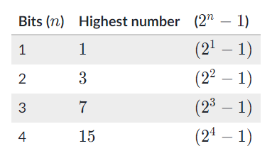
There's another interesting pattern in binary numbers. Take a look at these:
Each of the decimal numbers are a power of 2, minus 1: 4-1=3, 8-1=7, 16-1=15. When a binary number has a 1 in each of its places, then it will always equal the largest number that can be represented by that number of bits. If you want to add 111 to that number, you need to add another bit. It's like 9, 99, and 999 in the decimal system.
As it turns out, the highest number that can be represented by n bits is the same as 2^n - 1:

Slide 14
What do you think: what does 11111 represent in decimal?
Notes:
🍐 This is a Pear Deck Multiple Choice Slide. Your current options are: A: 63, B: 15, C: 24, D: 31,
🍐 To edit the type of question or choices, go back to the "Ask Students a Question" in the Pear Deck sidebar.
You could calculate that using our strategy from before fairly quickly. However, there's one more strategy, keeping in mind what we just learned: you could count the number of bits (555), calculate 2^52
5
2, start superscript, 5, end superscript as 2 \times 2 \times 2 \times 2 \times 2 = 322×2×2×2×2=322, times, 2, times, 2, times, 2, times, 2, equals, 32, and then subtract 111.
All of this is to help you gain a more intuitive understanding of binary. You may not remember all of this, and that's okay. There's lots of practice coming up for you to build your skills.

Slide 15

🙋🏽🙋🏻‍♀️🙋🏿‍♂️Do you have any questions about this topic?
Notes:
🍐 This is a Pear Deck Text Slide
🍐 To edit the type of question, go back to the "Ask Students a Question" in the Pear Deck sidebar.

Slide 16
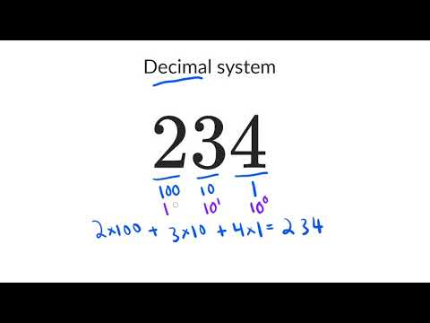
Decimal system refresher

Slide 17
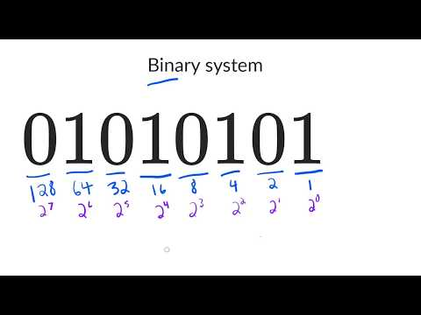
The binary number system

Slide 18
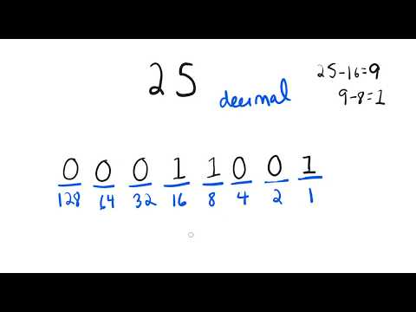
Converting decimal numbers to binary

Slide 19
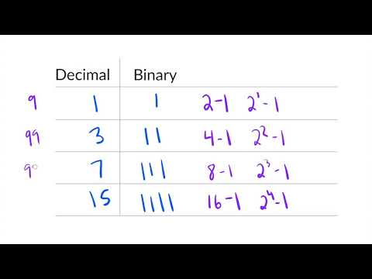
Patterns in binary numbers

Slide 20


Slide 21
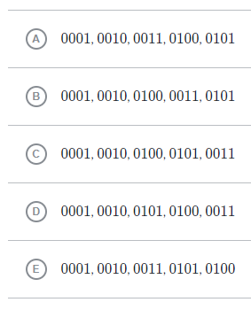
Which of these lists correctly counts from 1 to 5 in binary?
Notes:
🍐 This is a Pear Deck Multiple Choice Slide. Your current options are: A: A, B: B, C: C, D: D, E: E,
🍐 To edit the type of question or choices, go back to the "Ask Students a Question" in the Pear Deck sidebar.

Slide 22
Your classmate constructs a simple computer that adds numbers. There are 5 wires for inputting the first number, and the wires are currently "on", "on", "off, "on", "off", or 11010 in binary.
What decimal number does that represent?
Notes:
🍐 This is a Pear Deck Text Slide
🍐 To edit the type of question, go back to the "Ask Students a Question" in the Pear Deck sidebar.

Slide 23
It's your friend's birthday, and you want to use binary numbers for the candles on their cake. Your plan is to use green candles to mean "on" and gray candles to mean "off".
What's the least number of candles you need in order to represent the age 18?
Notes:
🍐 This is a Pear Deck Text Slide
🍐 To edit the type of question, go back to the "Ask Students a Question" in the Pear Deck sidebar.

Slide 24
You've decided to use binary to communicate "secret" messages to your friend, and you want to tell them to meet you at locker 44.
What would that decimal number be in binary?
Type the binary number without any spaces:
Notes:
🍐 This is a Pear Deck Text Slide
🍐 To edit the type of question, go back to the "Ask Students a Question" in the Pear Deck sidebar.

